Slide 1
Effective Portfolio Management with Kanban
Mahesh Singh/ Avinash Rao
Digité, Inc.

Slide 2
Agenda
Key Objectives of Portfolio Management
Challenges of traditional Portfolio Management
Features of Kanban that lend it to Portfolio Management
Focus on Upstream
Demand Shaping (and Capability balancing)
Cost of Delay Function
Delayed Decision-making
Forecasting/ Simulation
Visualization
Scalability

Slide 3
Key Objectives of Portfolio Management
Bubble up the Right Strategy Ideas/ Initiatives to the top
Prioritize the Right Initiatives (at the Right Time)
Identify Ideas/ Requests/ Initiatives
Analyze and Prioritize
Align Strategy To Execution
Keep Stakeholders informed
Make Funding Go/ No Go Decisions
Provide insights into health of current Investments in play

Slide 4
Lets see how this usually works in practice
Executive pick the right set of projects and programs to fund (of course)
The projects and programs are allocated a budget based on the ROI they are expected to provide (always!)
These are then executed in a successful manner, which leads to the ROI and business objectives being met, which, of course, leads to a successful Portfolio (and we all get promoted!)

Slide 5
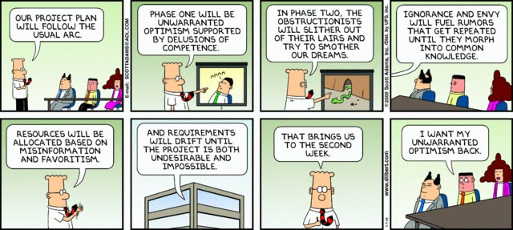
Dilbert: “Our Project Plan Will Follow the Usual Arc”
No? Doesn’t sound familiar?
Notes:
https://www.joeydevilla.com/2008/11/09/dilbert-our-project-plan-will-follow-the-usual-arc/

Slide 6
Lets see how this usually works in practice
But it isn’t necessarily the fault of the executives or the portfolio manager, or the execution teams.
Why not?

Slide 7
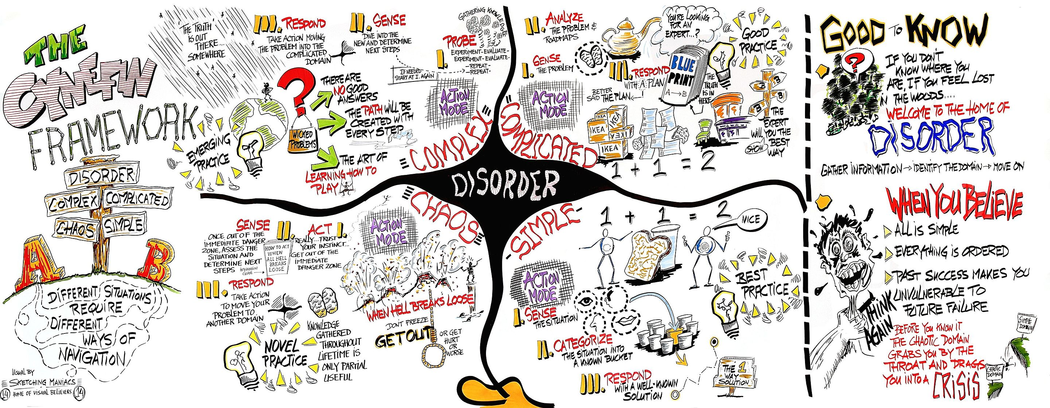
Portfolios are frequently Complex

Slide 8
Which means …
In today’s marketplace, there is ever increasing change and competition
Best or even Good practices are unlikely to lead to the desired outcomes
Complex portfolios need for us to Probe, Sense and Respond on an ongoing basis
This is different from the traditional instinct to plan and control (where you can sense, plan and respond) which works reasonably in Simple or even Complicated scenarios)

Slide 9
Is there no hope then?
To handle a portfolio of complex programs and projects, we need a way to plan and execute in shorter, incremental cycles
We need to be able to probe proactively and sense the progress of the individual tracks, and respond with interventions
These interventions can be additional support to re-align the progress, or early discard of the tracks where no progress is being made (or cost of progress is too high)

Slide 10
To achieve these, we need:
First, we need visibility into potential tracks in the portfolio, along with ongoing work
We need a way to evaluate on an ongoing basis the value of these tracks
Once commissioned, we need to understand the progress of each track, and impediments
Finally, we need to re-allocate to back winners and prune (potential) failures early

Slide 11
Key Features of Kanban that enable Portfolio Management
Lean Portfolio Management
Planning in Shorter Horizons
Data-based Forecasting/ Capacity Planning
Prioritization by Evaluating Opportunity Cost
Cost of Delay
Risk Profiling
Tracking, Monitoring, Aligning
Dependency Management
Forecasting/ What-if Analysis
Transparency of the Portfolio Lifecycle
Visibility
Accurate/ Easy Status Reporting
Alignment of Strategy to Execution
Visibility to Leadership
Effective Coordination
Context/ Purpose for Teams
To Achieve

Slide 12
”But I thought Kanban is for IT/ Ops..?!”
Kanban is not just for IT/ Ops
Kanban is not just a “Ready – Doing – Done” Board
Kanban is Scalable – Vertically AND Horizontally

Slide 13
Lean/ Agile Portfolio Management
Shorter Planning Cycles
Quarterly/ Monthly Planning
Booking Capacity based on known Throughput/ Velocity & Probabilistic Forecasting
Feedback Loops and Frequent Adjustment cycles
PDCA
Probe, Sense, Respond
Fail Fast, Fail Often

Slide 14
Prioritization – as delayed as possible
Delay decisions till the “last responsible moment”
Selection of Options
Funding
Execution
Enable change in direction based on market forces
Allow customers to change priorities
Focus on the most important (top 5 or 10)
Avoid shelving / cancelling projects once initiated
Discard instead of Abort

Slide 15
Discard, instead of Abort
Maximize Throughput!!
Abort
Discard/ Divert
Commitment Point
Notes:
So what does Upstream Kanban do? (Walk thru the image animation)
Creates greater understanding of Delivery team capacity/ capability
Helps them respect WIP Limits – both Min and Max
Gives a better understanding of Delivery Cadence – and hence more efficient Replenishment
Helps manage the biggest challenge Dev teams typically face – overburdening/ large backlogs
Ensures a smoother flow
Provides both sides strong reasons to stay invested in Kanban!!!

Slide 16
Prioritization – as delayed as possible
Cost of Delay
How late can we start this initiative in order to minimize cost of delay?
Too early a start can result in opportunity cost
Too late a start usually results in missed windows of opportunity
What is the Cost?
Cost of Delay function
Probability distribution of completion time (Lead Time)
Risk Profiling/ Demand Shaping
What is the risk of doing/ not doing something?
What is the organization’s risk appetite?
Upstream Kanban/ Patrick Stayeart

Slide 17
Tracking/ Monitoring/ Forecasting
Managing Dependencies
Within and across teams
Customer/ Supplier dependencies/ blockers
Capacity/ Capability Bottlenecks
Balancing Capacity and Demand
Forecasting
Linear Regression
Lead Time Distribution - Actual
Lead Time Probability - Forecast

Slide 18
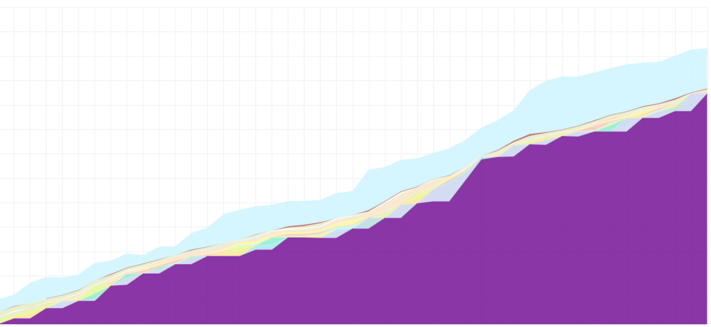
The Cost of Failure Keeps Going Up
Notes:
https://www.bluecart.com/blog/manufacturing-inventory

Slide 19
Transparency/ Visibility
Visualization at ALL levels
Portfolio/ OKR → Program → Project → Tasks
Theme → Epic → User Stories → Tasks
Simplified Status Rollup, based on
Cards
Tasks
Effort
Interconnected Boards/ Swim Lanes
Flight Levels/ Klaus Leopold

Slide 20
True Alignment of Strategy to Execution
Visibility to Leadership
“Are we on target with this OKR/ Initiative?”
“How is it being executed?”
“What has been completed? In-flight? Delayed?”
Context to Delivery Teams
”Why are we doing what we are doing?”
“What is the purpose of this?”
Effective Coordination
Program Boards (Flight Level 2)

Slide 21
A Quick Demo: Portfolio Management with SwiftKanban
Aligning Strategy to Execution

Slide 22
Questions?

Slide 23
Thank you!
Mahesh Singh
Co-founder, SVP – Marketing/ Consulting
AKT/ AKC
https://www.digite.com/swiftkanban
@maheshsingh
mahesh@digite.com
+1 (408)761-2238
https://www.linkedin.com/in/singhmahesh/

