Slide 1
Three Key Factors in Successful SAFe® Implementations
Digité, Inc. Sept 15th, 2020

Slide 2
Agenda
Introductions
A Quick word about Digité, Inc.
Three Key Factors in Successful SAFe Implementations
Q&A

Slide 3
Some Housekeeping
The webinar is being recorded. The recording will be made available.
Questions will be taken via Q&A box on the right side of your screen. Please enter your question at any time. We will take as many of them as time permits at the end of the webinar.

Slide 4
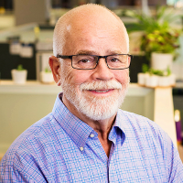
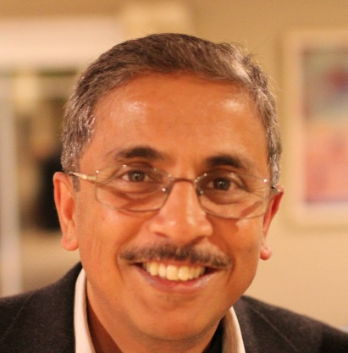
Introductions
Speaker: Dean Leffingwell
Co-founder and Chief Methodologist Scaled Agile, Inc
Host: Mahesh Singh
Co-founder, SVP – Marketing
Digité, Inc.

Slide 5
Dean Leffingwell
Dean Leffingwell is recognized as one of the world’s foremost authorities on Lean-Agile best practices
He is an author, entrepreneur, and software development methodologist
Founder of several successful startups, including Requisite, Inc., makers of RequisitePro (acquired by Rational), Dean also served as Chief Methodologist to Rally Software, and prior to that, as a Sr. Vice President at Rational Software (now part of IBM)
He currently serves as Chief Methodologist to Scaled Agile, Inc., which he co-founded in 2011

Slide 6
Digité, Inc.
Pioneer in Web-based Collaborative Products/ Solutions for Geographically Distributed Teams since 2002
Headquartered in Cupertino, Ca; presence in US, UK and India
Nearly 1m users in the Americas, Europe, Asia/ Pacific
Products that cover Lean/ Kanban, Agile ALM, Project/ Portfolio Management
SwiftEASe – “Built for SAFe” Lean and Visual SAFe Tool

Slide 7
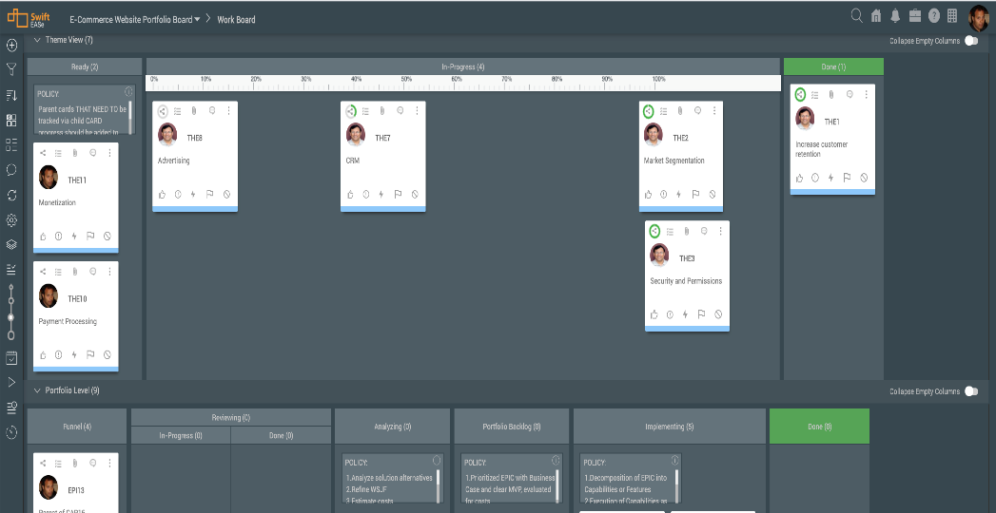
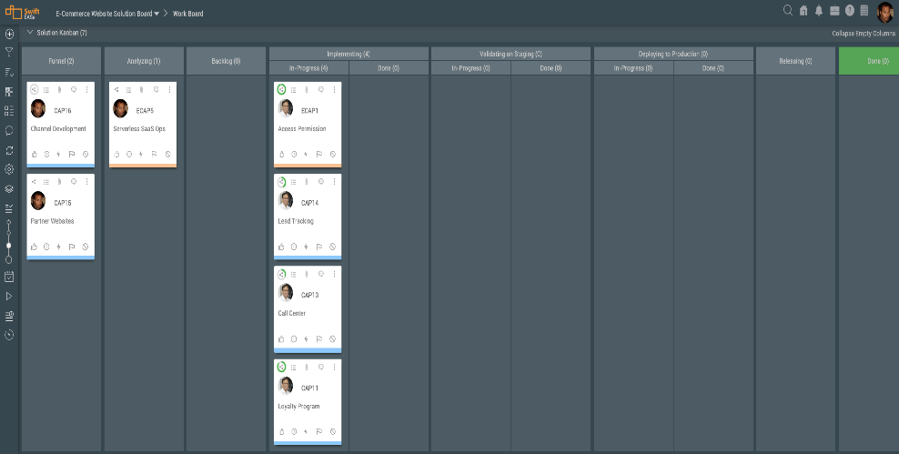
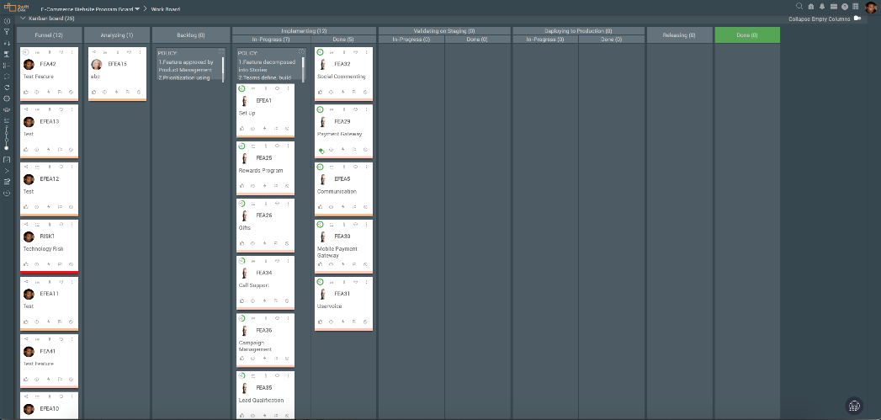
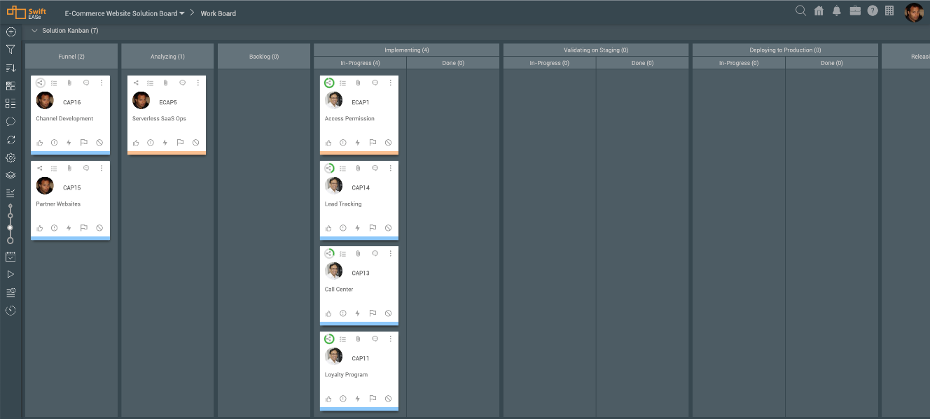
Visual Management: Work Boards for each Level
Pre-defined Work Boards with Value Streams for each Level
Automatic Definition of Board Hierarchy
Configurable number of Levels to Support Essential SAFe all the way to Full SAFe
Support for SAFe 4.5 and 5.0
Portfolio Work Board
Large Solution Work Board
Program Work Board
Team Work Board

Slide 8
Visual Management: Work decomposition and hierarchy
Create configurable levels of work decomposition
Define your own configurable work items types and define parent-child relationships that suit your needs.
Rolls up data from the child cards to the parent cards across all levels of hierarchy

Slide 9
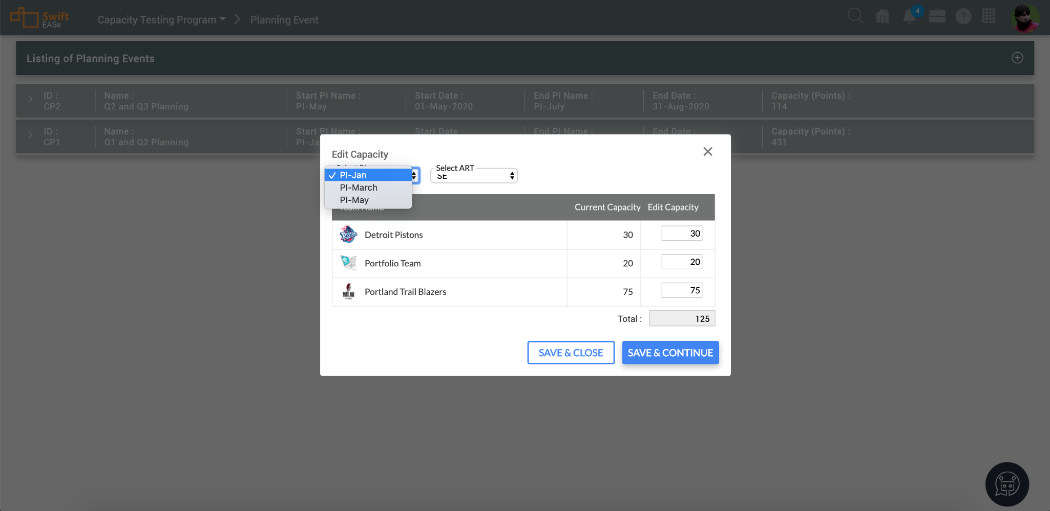
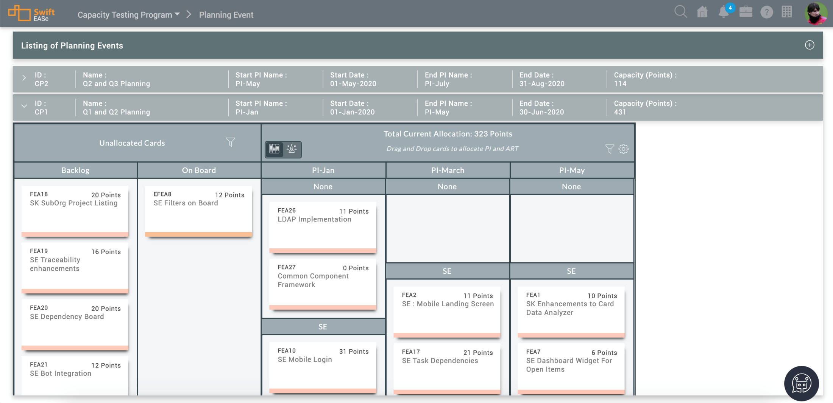
PI – High Level Capacity Planning

Slide 10
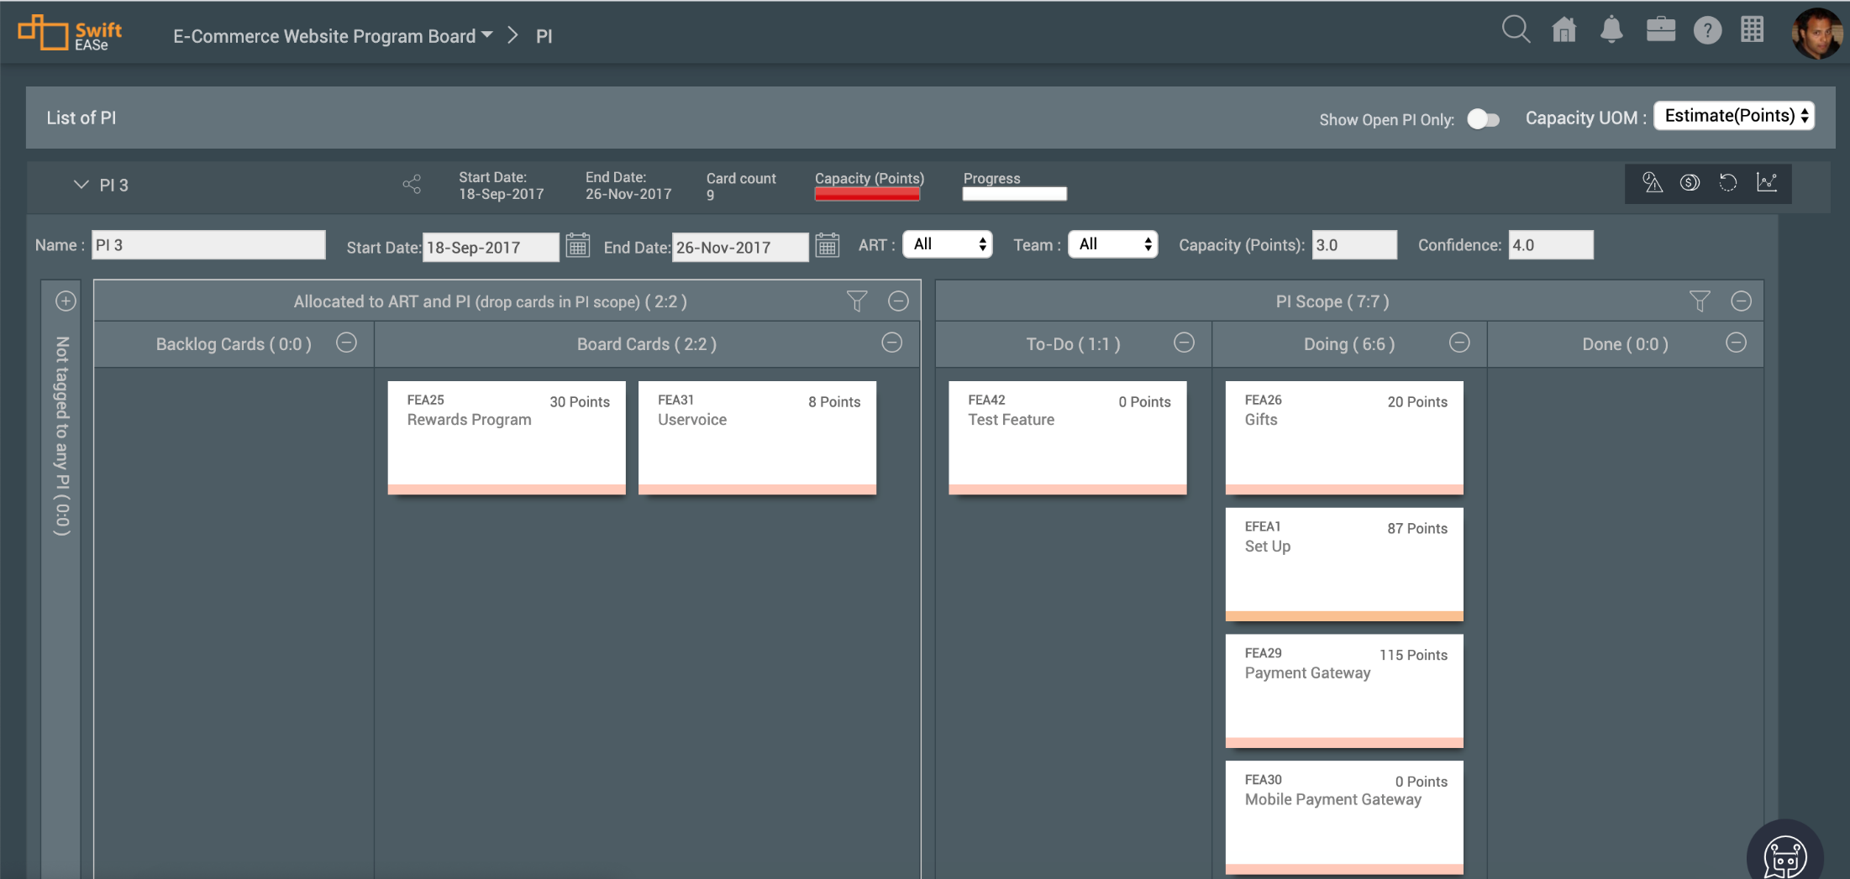
Collaborative PI & Spring Planning

Slide 11
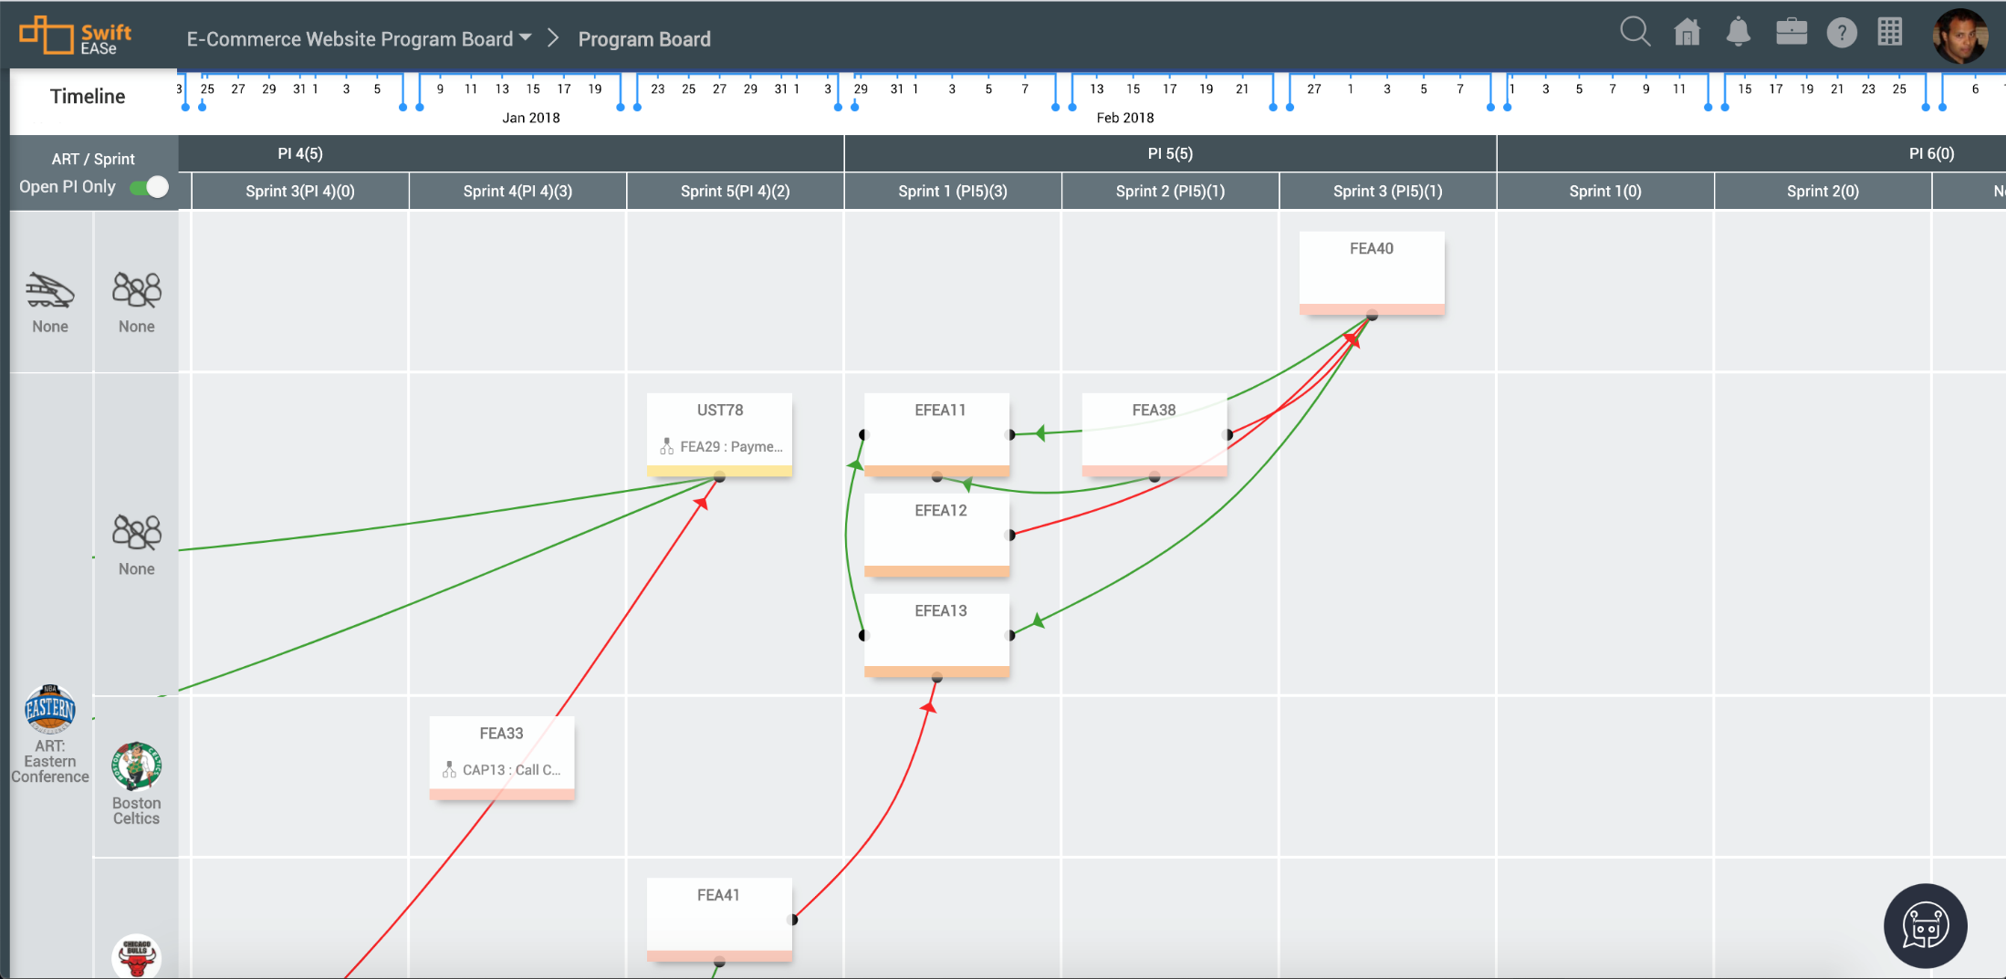
Distributed Program Board/ Dependency Management

Slide 12
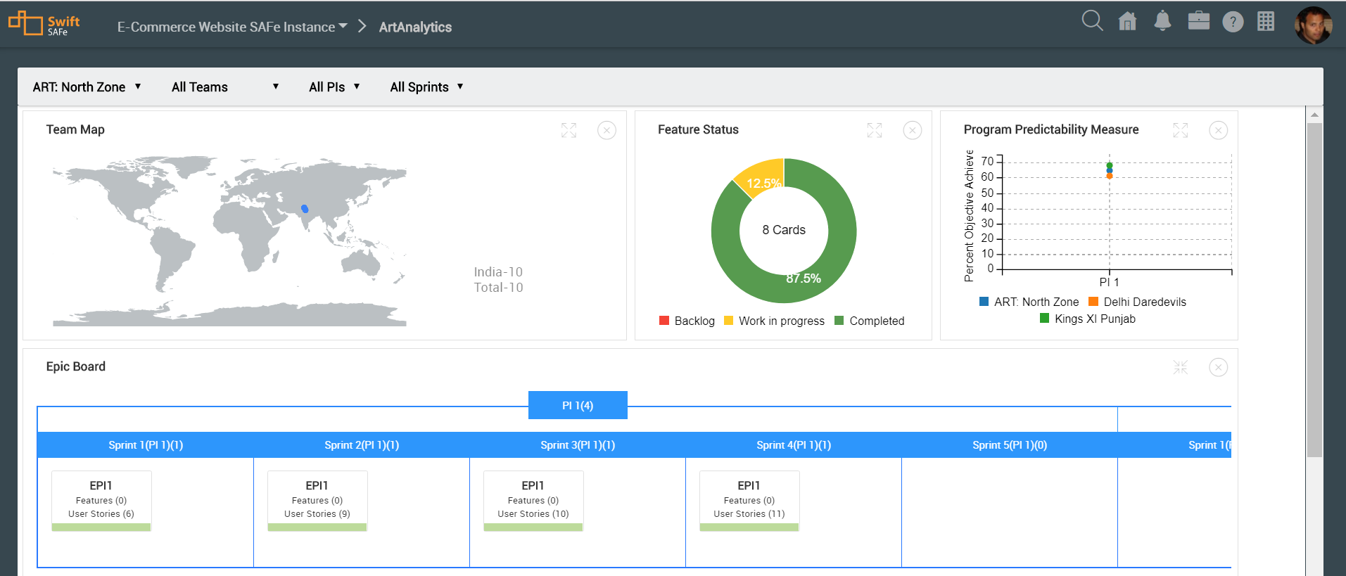
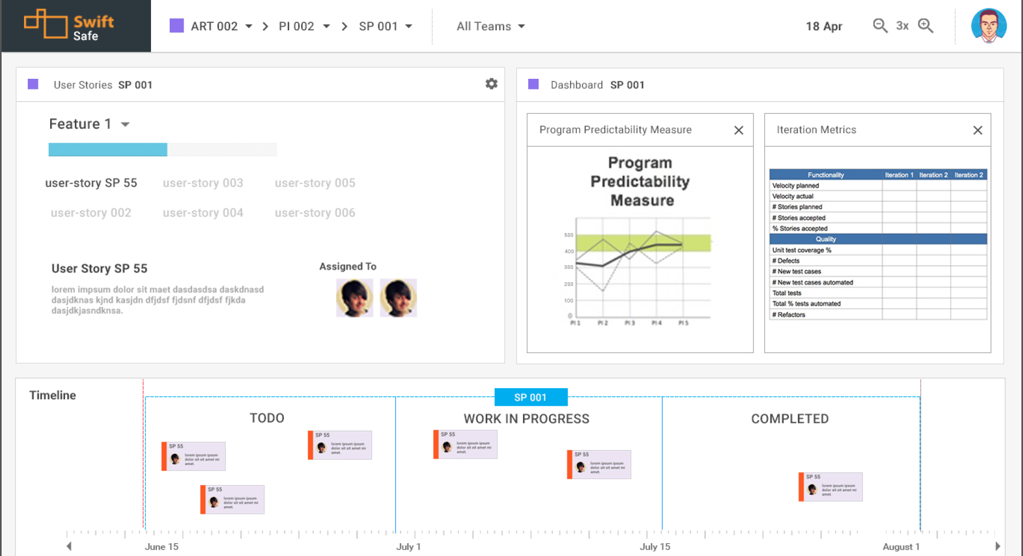
ART Analytics Drill-down from Multi-PI to Single Sprint

Slide 13
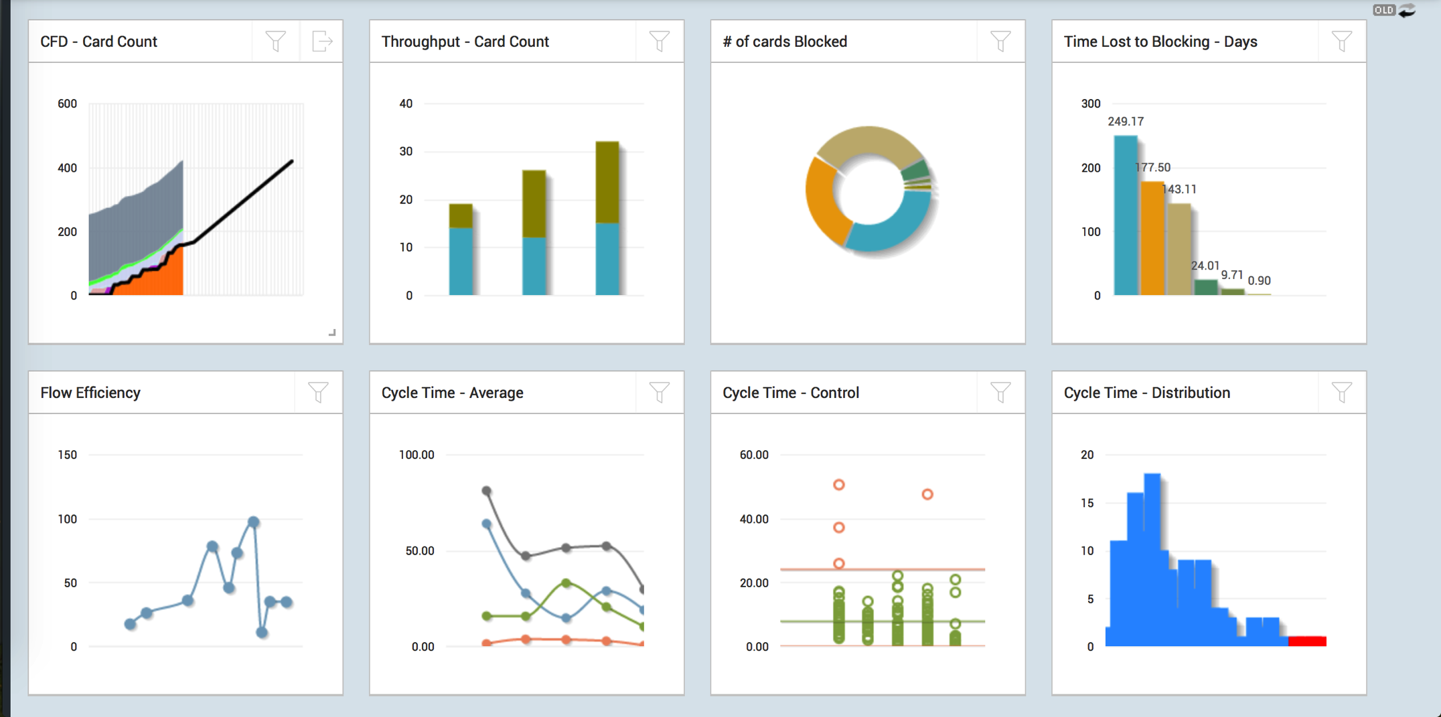
Lean/ Flow Analytics Support for Continuous Improvement

Slide 14
SwiftSync Integration Platform Rich ALM/ PPM/ CRM Ecosystem (Over 60 tools)

Slide 15
Key Customers

Slide 16
Over to Dean…
Notes:
Dragos general introductions
Jim Gawtry and Gary Perkerwicz work for ATK a company with leadership positions in Outdoor Sports and Aerospace and Defense (A&D). They have worked with each other for over 25 years.
During that time, they have seen a lot of improvement initiatives come and go including BPM, JIT, TQM and others. None of these initiatives made an impact to their work or culture.
There is something different about their current initiative and that is why we are here: to share a success story that other companies have been equally successful at adopting in the last couple of years: improving work flows and organizational culture using Lean principles and Kanban systems.

Slide 17
Q&A
Please ask your questions using the Q&A Box on the right side of your screens.
We will take up questions in the sequence in which they are received.
We appreciate your cooperation!!

Slide 18
Q&A
Dean Leffingwell
dean.leffingwell@scaledagile.com
@Deanleffingwell
Mahesh Singh
mahesh@digite.com
@maheshsingh
Digité/ SwiftEASe
www.digite.com
sales@digite.com

