Slide 1
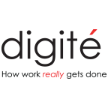
Discovering Discovery Kanban
Brought to you by:

Slide 2
Agenda
Introductions
A Quick word from the Sponsor
Discovering Discovery Kanban
- Anna Radzikowska
Q&A

Slide 3
Some housekeeping
The webinar is being recorded.
The recording will be made available.
Questions will be taken via the Questions box on the right side of your screen. Please enter your question at any time. We’ll take as many of them as time permits at the end of the webinar.

Slide 4
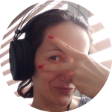
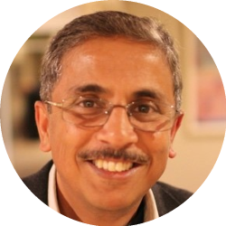
Introductions
Speaker: Anna Radzikowska
Product Manager, Kanban Maturity Model
Host: Mahesh Singh
Co-founder, CMODigité, Inc.

Slide 5
Anna Radzikowska
Has over 13 years of experience in finance, training, and project management: working in the public sector, big companies and running her own business
Is kaizen culture and Kanban method passionate. Being an ACCA member helps her to better understand the business which she’s working with but also gives her another angle view on different aspects of software development and product support
Currently works as Product Manager, Kanban Maturity Model, which supports modern businesses in growing into fit for purpose organizations

Slide 6
Quick word from the Sponsor - Digité, Inc.
Pioneer in Web-based Collaborative Products/ Solutions for Geographically Distributed Teams
Headquartered in Cupertino, CA
Nearly 1m users in the Americas, Europe, Asia/ Pacific
Products that cover Lean/ Kanban, Agile ALM, Project/ Portfolio Management
SwiftKanban and SwiftEASe

Slide 7
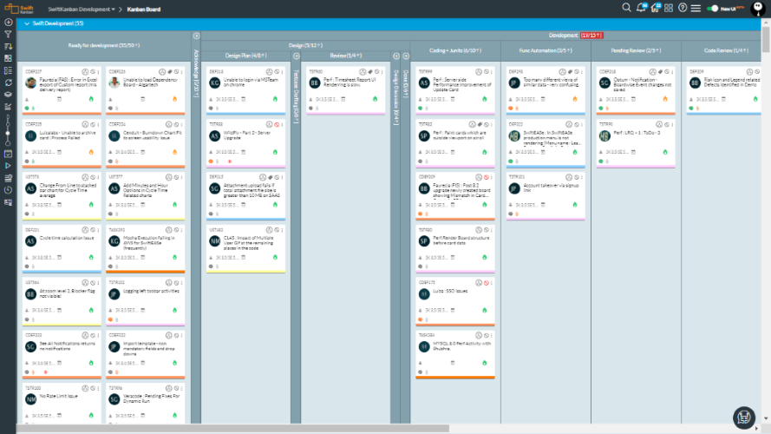
Kanban/ Scrumban Software Development/ IT/ DevOps

Slide 8
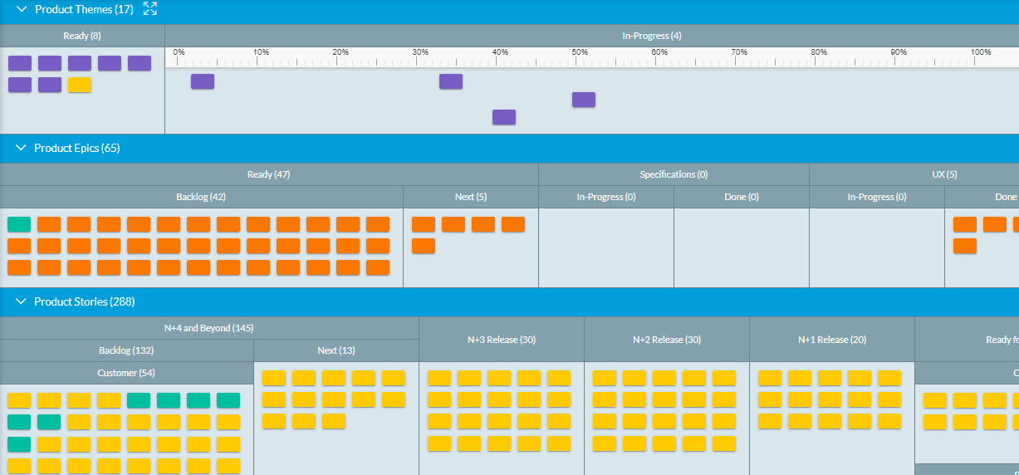
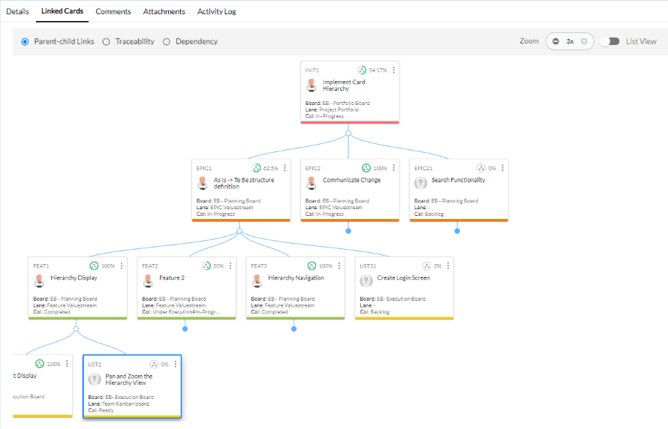
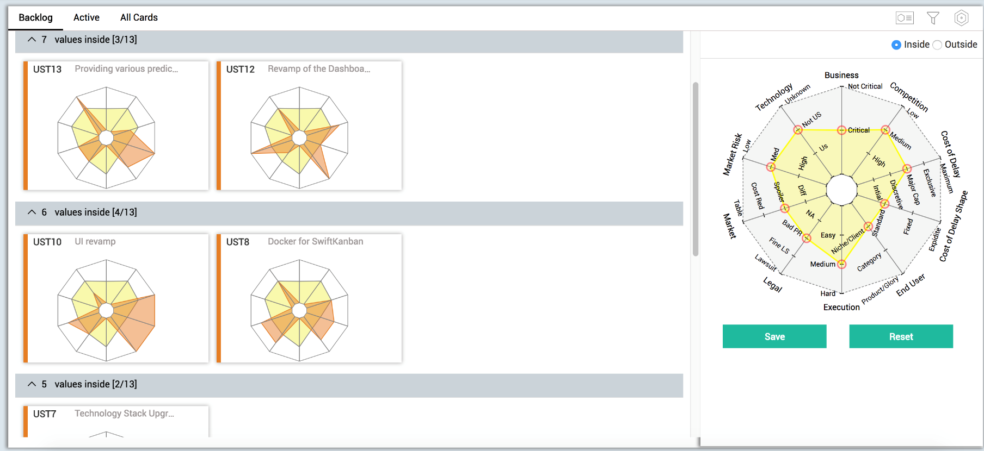
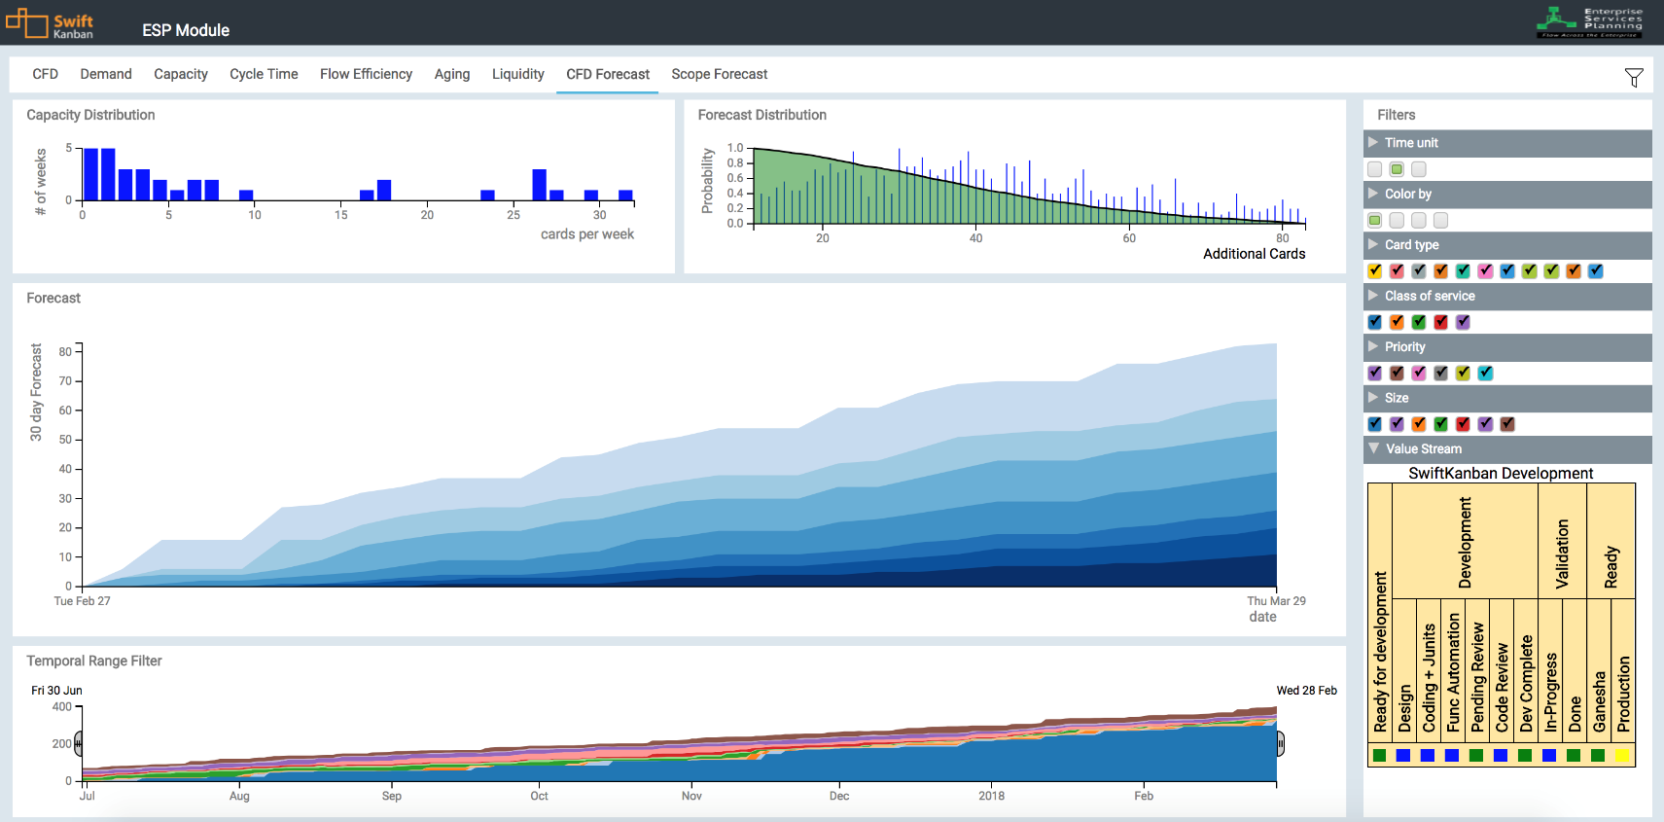
Visual Portfolio Management Portfolio Kanban/ Enterprise Services Planning

Slide 9
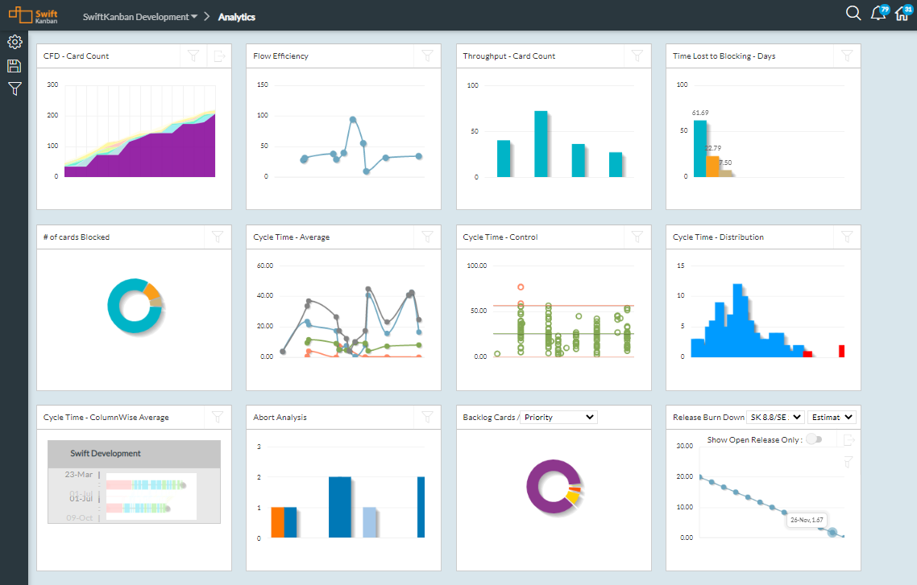
SwiftKanban Analytics

Slide 10
Integrations: SwiftSync, Zapier, REST API Rich ALM/ PPM/ CRM Ecosystem

Slide 11
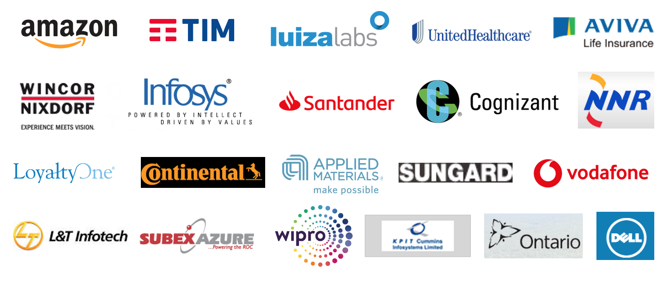
Our Customers

Slide 12
Over to Anna…
Notes:
Dragos general introductions
Jim Gawtry and Gary Perkerwicz work for ATK a company with leadership positions in Outdoor Sports and Aerospace and Defense (A&D). They have worked with each other for over 25 years.
During that time, they have seen a lot of improvement initiatives come and go including BPM, JIT, TQM and others. None of these initiatives made an impact to their work or culture.
There is something different about their current initiative and that is why we are here: to share a success story that other companies have been equally successful at adopting in the last couple of years: improving work flows and organizational culture using Lean principles and Kanban systems.

Slide 13
Q&A
Please ask your questions using the Q&A Box on the right side of your screens
We will take up questions in the sequence in which they are received
We appreciate your cooperation!

Slide 14
Reach out to Us
Anna Radzikowska
anna@mauvius.com @AnnaRadzikowsk5
Mahesh Singh
mahesh@digite.com @maheshsingh
www.digite.com sales@digite.com

Slide 15
Thank you

